Slide 1
TerraFly GeoHealth Public Health Analytics
Huibo Wang
Yun Lu
Yudong Guang
Erik Edrosa
Mingjin Zhang
Raul Camarca
Yelena Yesha
Tajana Lucic
Naphtali Rishe
© 2014 Florida International University and TerraFly.com

Slide 2
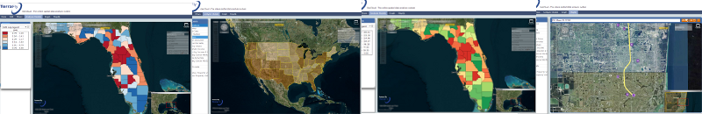
Introduction
GIS are growing at a very fast pace
Many functionalities are moving to online services
Few online services are suitable for geospatial epidemiology
TerraFly GeoCloud
Provides online spatial epidemiological analysis
Easy to use, no programming knowledge needed

Slide 3
Background
Geospatial Epidemiology
Describing and analyzing the geographic variations of disease spread
Focus areas:
Disease Mapping
Geographic correlation studies
Clustering, disease clusters, surveillance

Slide 4
Geospatial epidemiology
Disease maps
Visualization of health and disease correlated to geography, demographics, and environment
Mortality maps, morbidity maps, standardized mortality/morbidity ratio(SMR) maps, age-adjusted ratio maps
Identifying areas having high risk of disease contagion

Slide 5
Geospatial epidemiology
Geographic correlation studies
To understand the effect of various factors on the spread of diseases
Factors may include geography, socioeconomics, demographics, and lifestyle

Slide 6
Geospatial epidemiology
Disease Clusters and Disease Surveillance
Identifying groups that are at higher or lower risk of disease transmission
Analyzing clusters can help discover relative factors of the disease
Disease surveillance aims at monitoring the spread of disease and detecting outbreaks

Slide 7
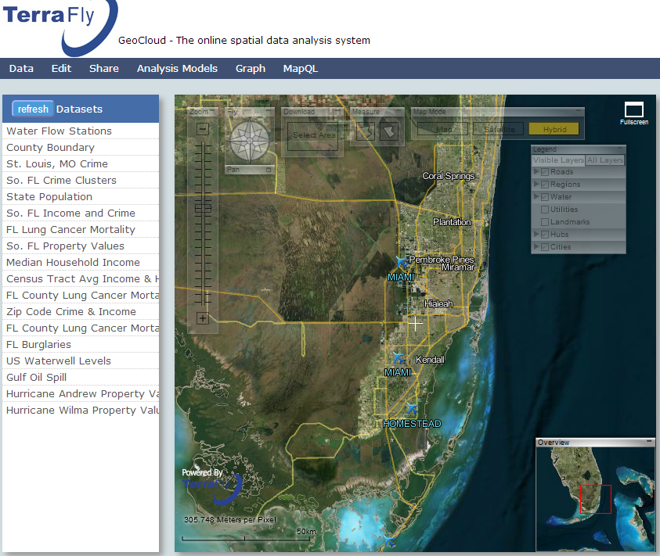
TerraFly GeoCloud
A system combining several technologies
TerraFly Map API
MapQL
Provides several analysis functions
Visualize data on the map and with charts

Slide 8
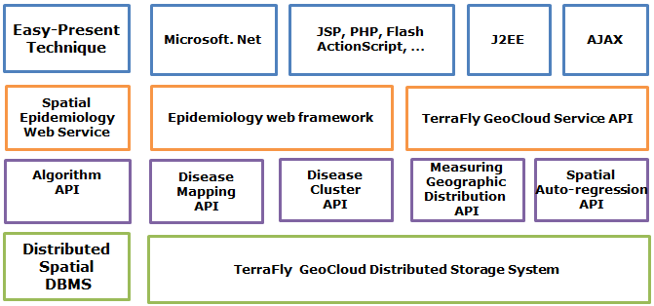
Spatial Epidemiology Analysis and Visualization System
Integrated into TerraFly GeoCloud
Demographic census and socioeconomic datasets
Tools provided:
Disease mapping
Disease cluster determination
Geographic distribution measurement
Regression

Slide 9
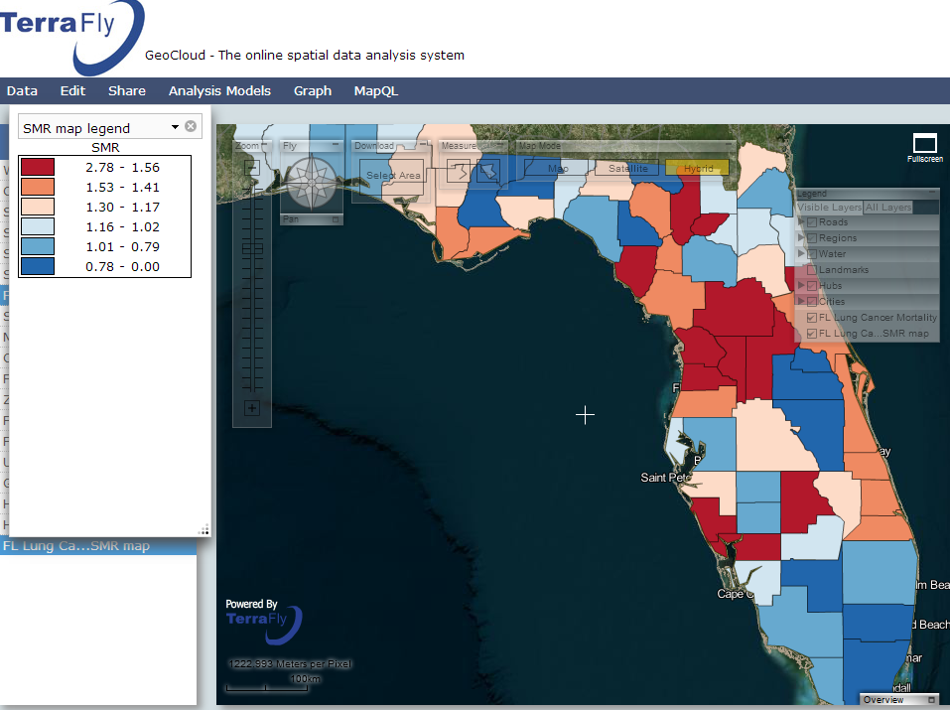
Analysis and Visualization
Disease mapping
Displays disease spread information on a map with a direct summary
Mortality/morbidity maps
SMR maps:
Ratio or percentage measuring the increase or decrease of mortality in a subarea compared to the entire area

Slide 10
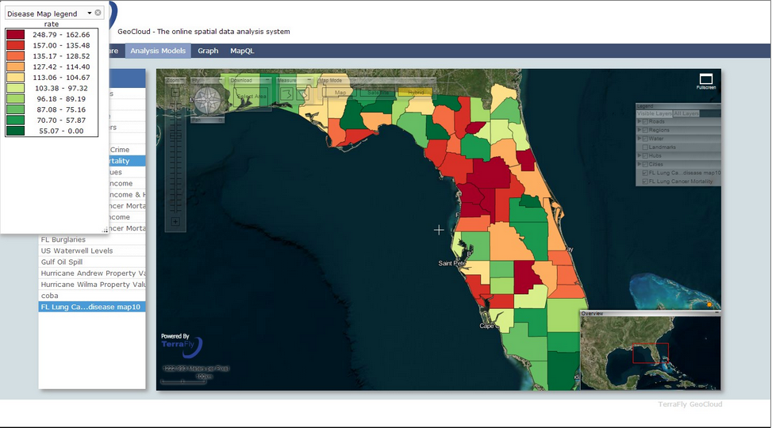
Disease map tool

Slide 11
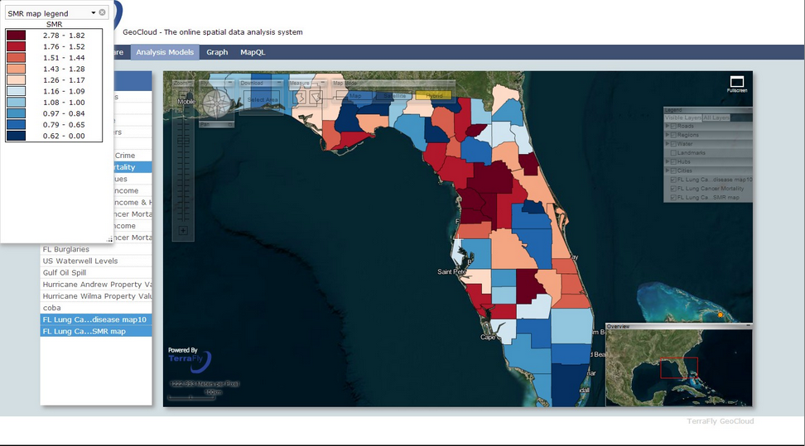
SMR map tool

Slide 12
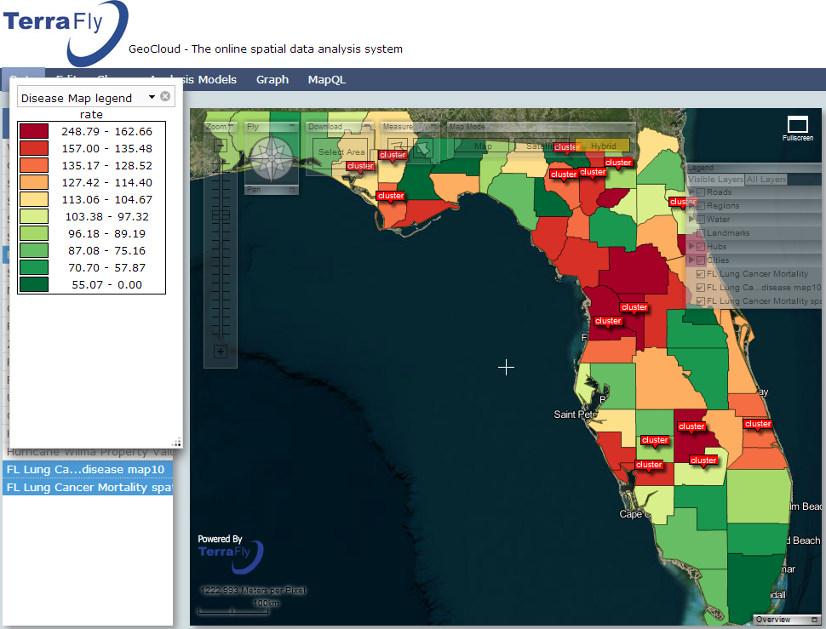
Analysis and Visualization
Clusters
Abnormal aggregations of disease cases in the same period and place.
Help in understanding disease spread mechanisms and control the spread of infectious disease
Disease cluster
HotSpot Analysis
Cluster and Outlier Analysis

Slide 13
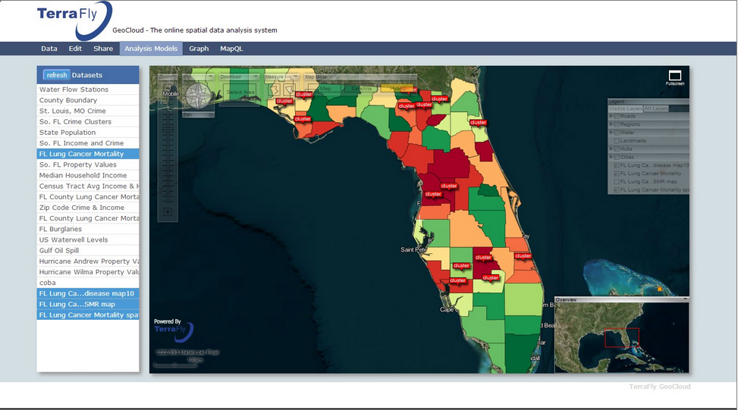
Spatial Cluster tool

Slide 14
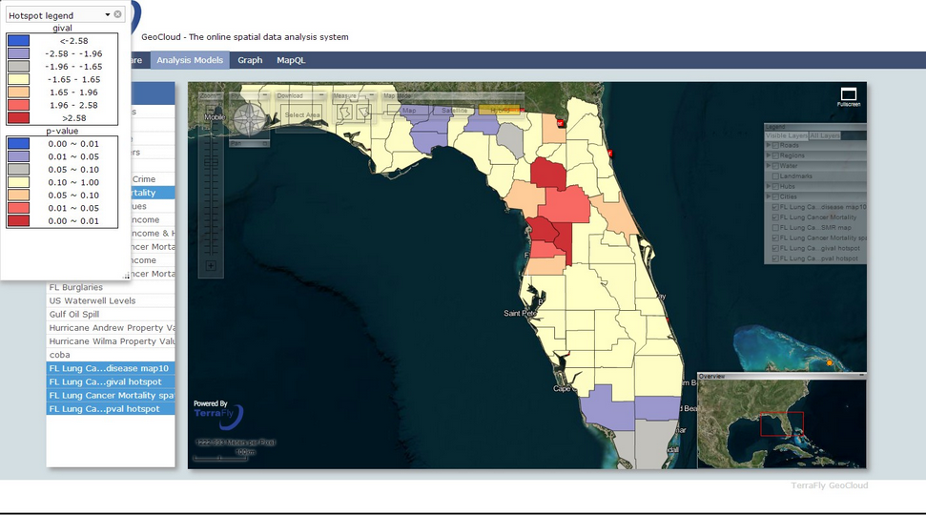
HotSpot Analysis tool

Slide 15
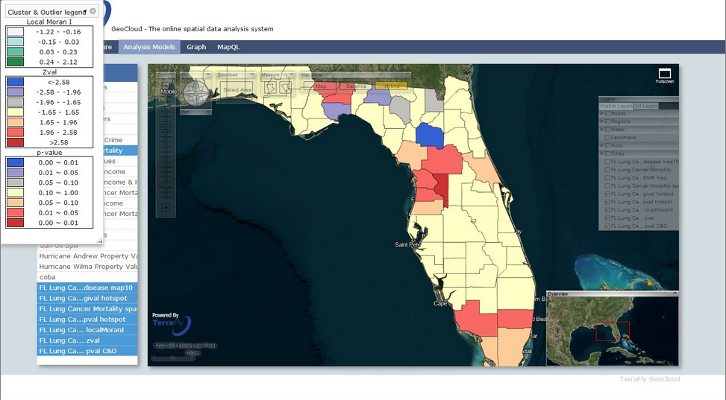
Cluster and Outlier Analysis

Slide 16
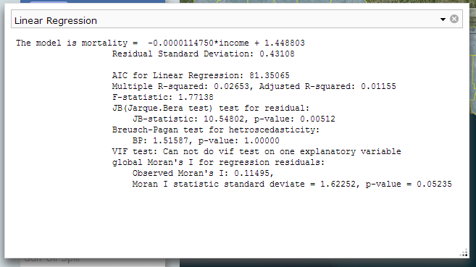
Analysis and Visualization
Regression
Estimate the relationships between disease data and secondary data.
Example: Socio-economic data
Linear regression
Test whether the dataset contains spatial correlation
Spatial auto regression
Lag model
Error model

Slide 17
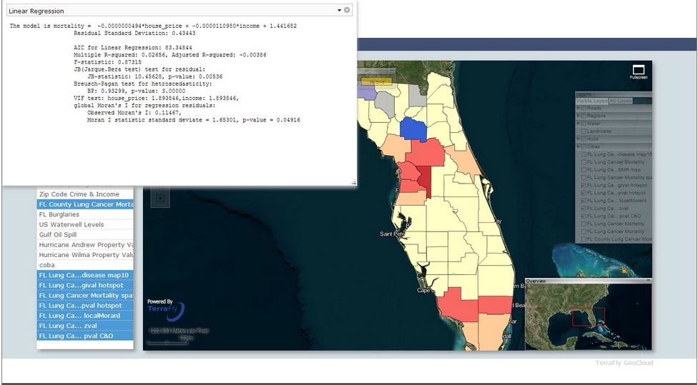
Linear Regression

Slide 18
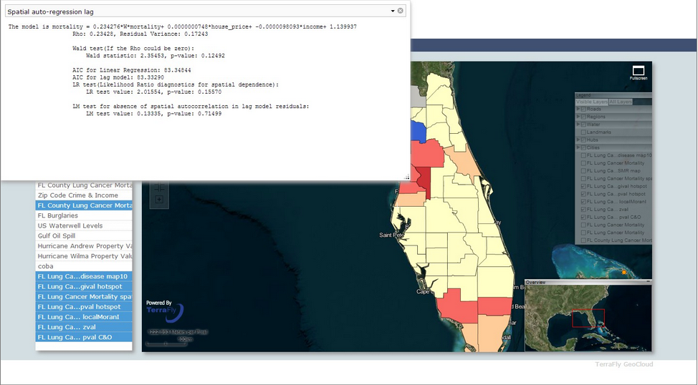
Spatial auto-regression lag model

Slide 19
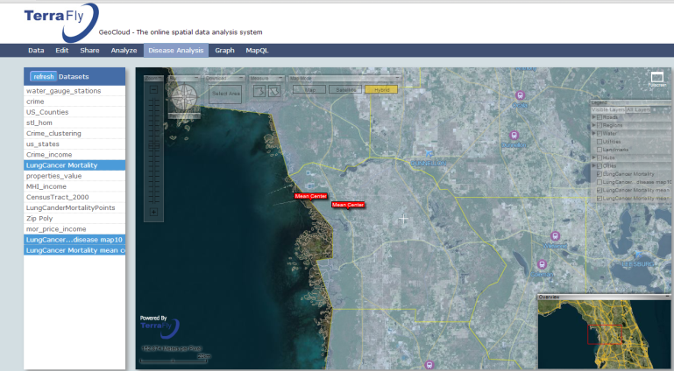
Analysis and Visualization
Geographic Distribution
Mean/median central
Standard distance
Distributional trends
Center Point
Weighed Center Point

Slide 20
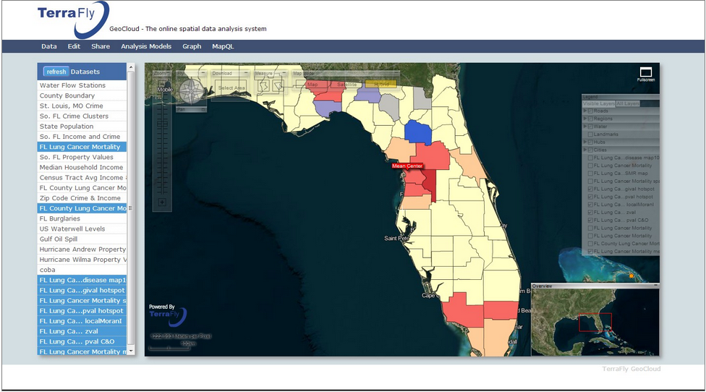
Mean Center tool

Slide 21
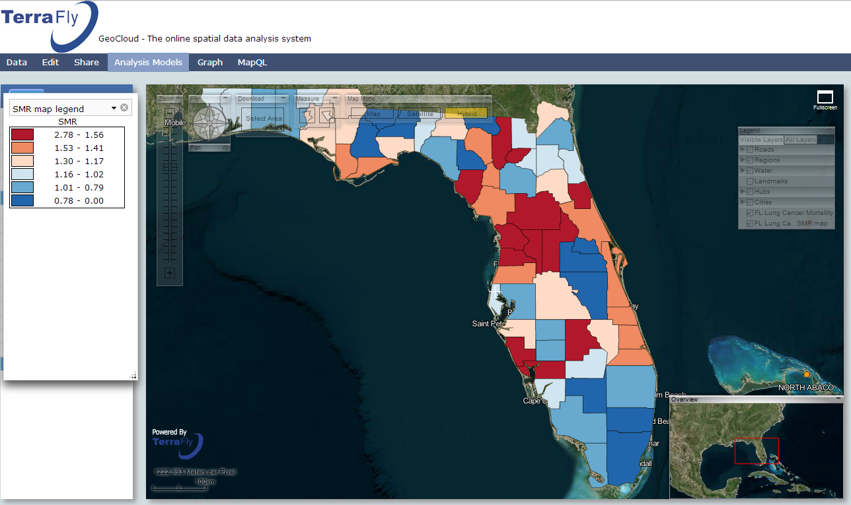
Thank you
questions?

